Slide 1
3GPP Standards Perspective
Compiled by :- Ast. Prof. Rashmi M. Pote
G. N. Khalsa college

Slide 2

 Overview
 Technical Challenges
 3GPP M2M Architecture
 Features and Enhancements

Slide 3

 Work on M2M standards is currently ongoing in several standardization bodies including 3GPP
 3GPP specifies standards for 2G, 3G and 4G wireless
communication technologies
 3GPP is also working on specifications for deploying M2M services over 2G/3G/4G networks
3GPP prefers to call it Machine-Type Communication (MTC)

Slide 4
Let’s watch a video
What is 3GPP ?
https://www.youtube.com/watch?v=mUFMqmCLRtg

Slide 5

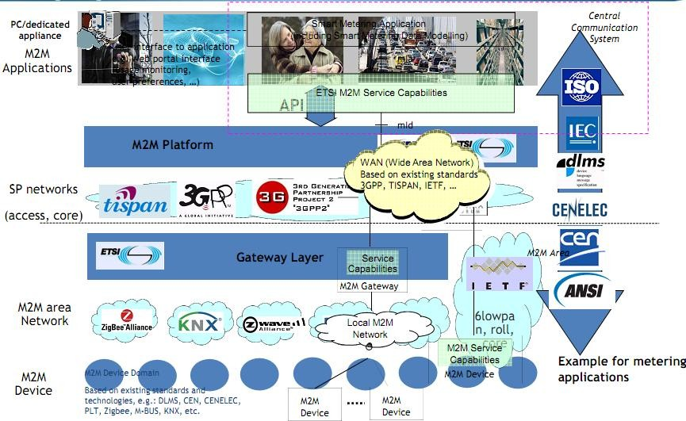
Source: ETSI

Slide 6

 Current mobile networks were designed for human- to-human and human-to-machine interactions
Telephony
SMS/MMS
Multimedia download and streaming
 M2M networks are characterised by
Communication that involves little or no human interaction
Large number of devices
Periodic or intermittent network access
Small amount of data per ‘session’

Slide 7
Let’s Watch a video.
Human-Machine Interaction
https://www.youtube.com/watch?v=kCHKJTyoO4M

Slide 8

Device/Service Characteristics | System Requirement
Low Mobility | Simplification of mobility control procedures
Time Controlled | Enable communication at specific times only
Time Tolerant | Low priority while allocating transmission resources
Small Data Transmissions | Reduction in control signaling and the number of concurrent/active network connections
Packet Switched Data Only | Access to services with or without a mobile number
Mobile Originated Only | Reduction in frequency of mobility control
Device Triggering | Transmission of trigger from network to control device
Device Grouping | Aggregate a set of devices to optimize control

Slide 9

 The following features and enhancements have been identified by 3GPP for Machine Type Communications
Overload/Congestion Control
Identifiers and Addressing
Triggering and Remote Management
Subscription Control and Charging
Security
Lower Device Cost

Slide 10


MTC App
MTC
Interworking
Function
MTC App
Operator Network
MTC Server
MTC Device

Slide 11

 Direct
The MTC Application communicates with the MTC device directly as an OTT (Over The Top ) application on mobile network
 Indirect
The MTC Application makes use of an MTC Server provided by
the operator
The interface between the MTC Server and the MTC application remains still out of the scope of 3GPP
The communication between the MTC server and the mobile network becomes internal to the PLMN ( Public Land Mobile Network.)

Slide 12

 Service Provider Controlled
The MTC Application makes use of an MTC Server, provided by
a third party Service Provider
The interface between the MTC server and the MTC application is totally out of the scope of 3GPP
The MTC server communicates with the 3GPP network by means of an interface or set of interfaces

Slide 13

MTC App
MTC App
MTC App
MTC Server
MTC Server
Operator Network
Operator Network B
Operator Network
MTC App
MTC App
MTC App
MTC App
MTC App
MTC App
MTC Device
MTC Device
MTC Device

Slide 14


